Slide 1
A

Slide 2
65

Slide 3
01000001

Slide 4
ASCII

Slide 5
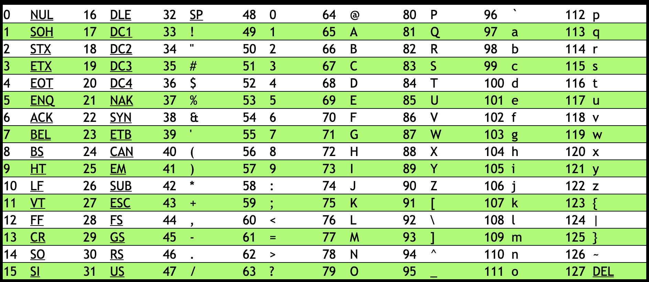

Slide 7
01001000 | 01001001 | 00100001

Slide 8
72 | 73 | 33

Slide 9
H | I
72 | 73 | 33

Slide 10
H | I | !
72 | 73 | 33

Slide 14
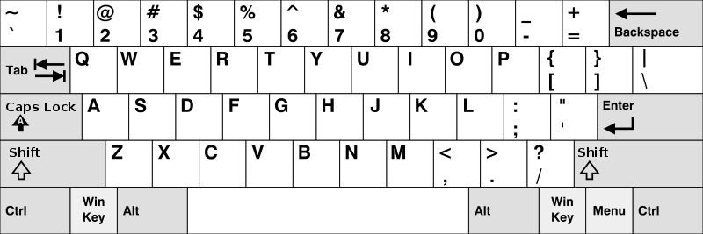

Slide 15
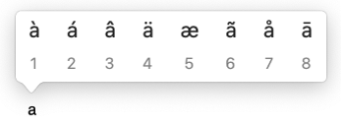

Slide 16
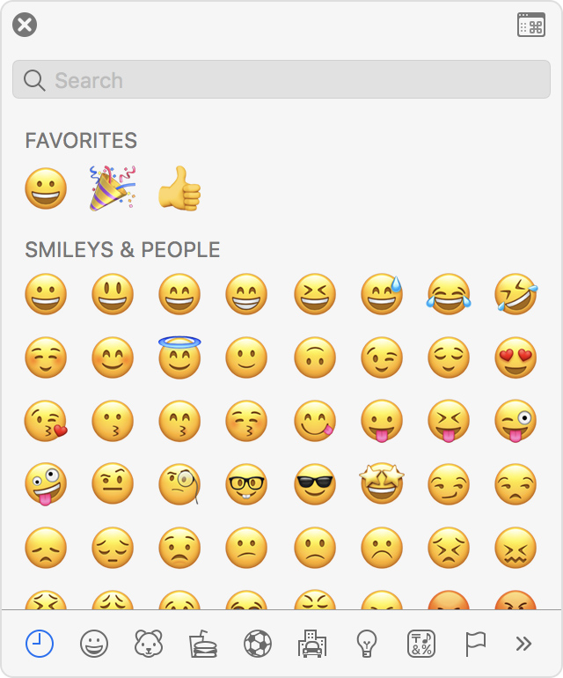

Slide 17
Unicode

Slide 18
11110000100111111001100010000010

Slide 19
4036991106

Slide 20


Slide 21


Slide 22
U+1F602

Slide 23
    

Slide 24

U+1F44D U+1F3FD

Slide 25

U+1F44D U+1F3FD

Slide 26

U+1F491

Slide 27

U+1F469 U+200D U+2764 U+FE0F U+200D U+1F468

Slide 28
U+1F469 U+200D U+2764 U+FE0F U+200D U+1F468

Slide 29
U+1F469 U+200D U+2764 U+FE0F U+200D U+1F468

Slide 30

U+1F469 U+200D U+2764 U+FE0F U+200D U+1F469

Slide 31

U+1F468 U+200D U+2764 U+FE0F U+200D U+1F468

Slide 32
RGB

Slide 34
72 | 73 | 33

Slide 35
72 | 73 | 33

Slide 39
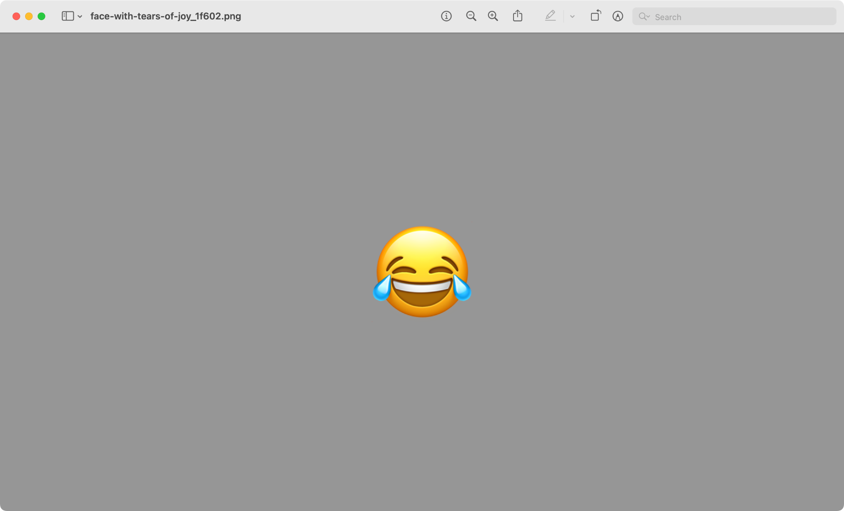

Slide 40
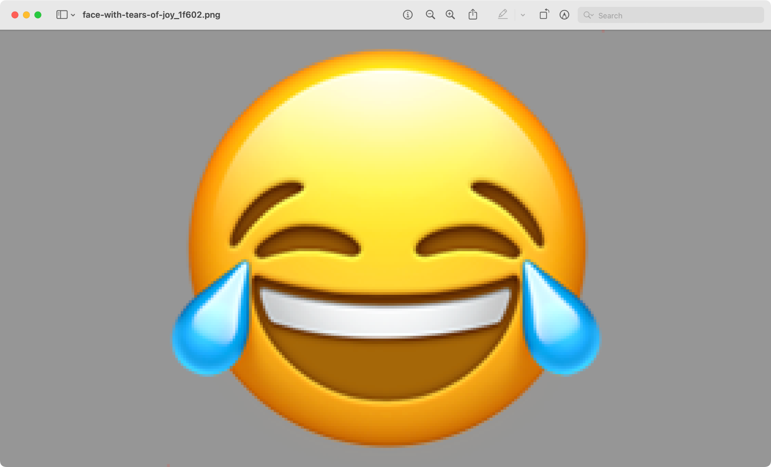

Slide 41
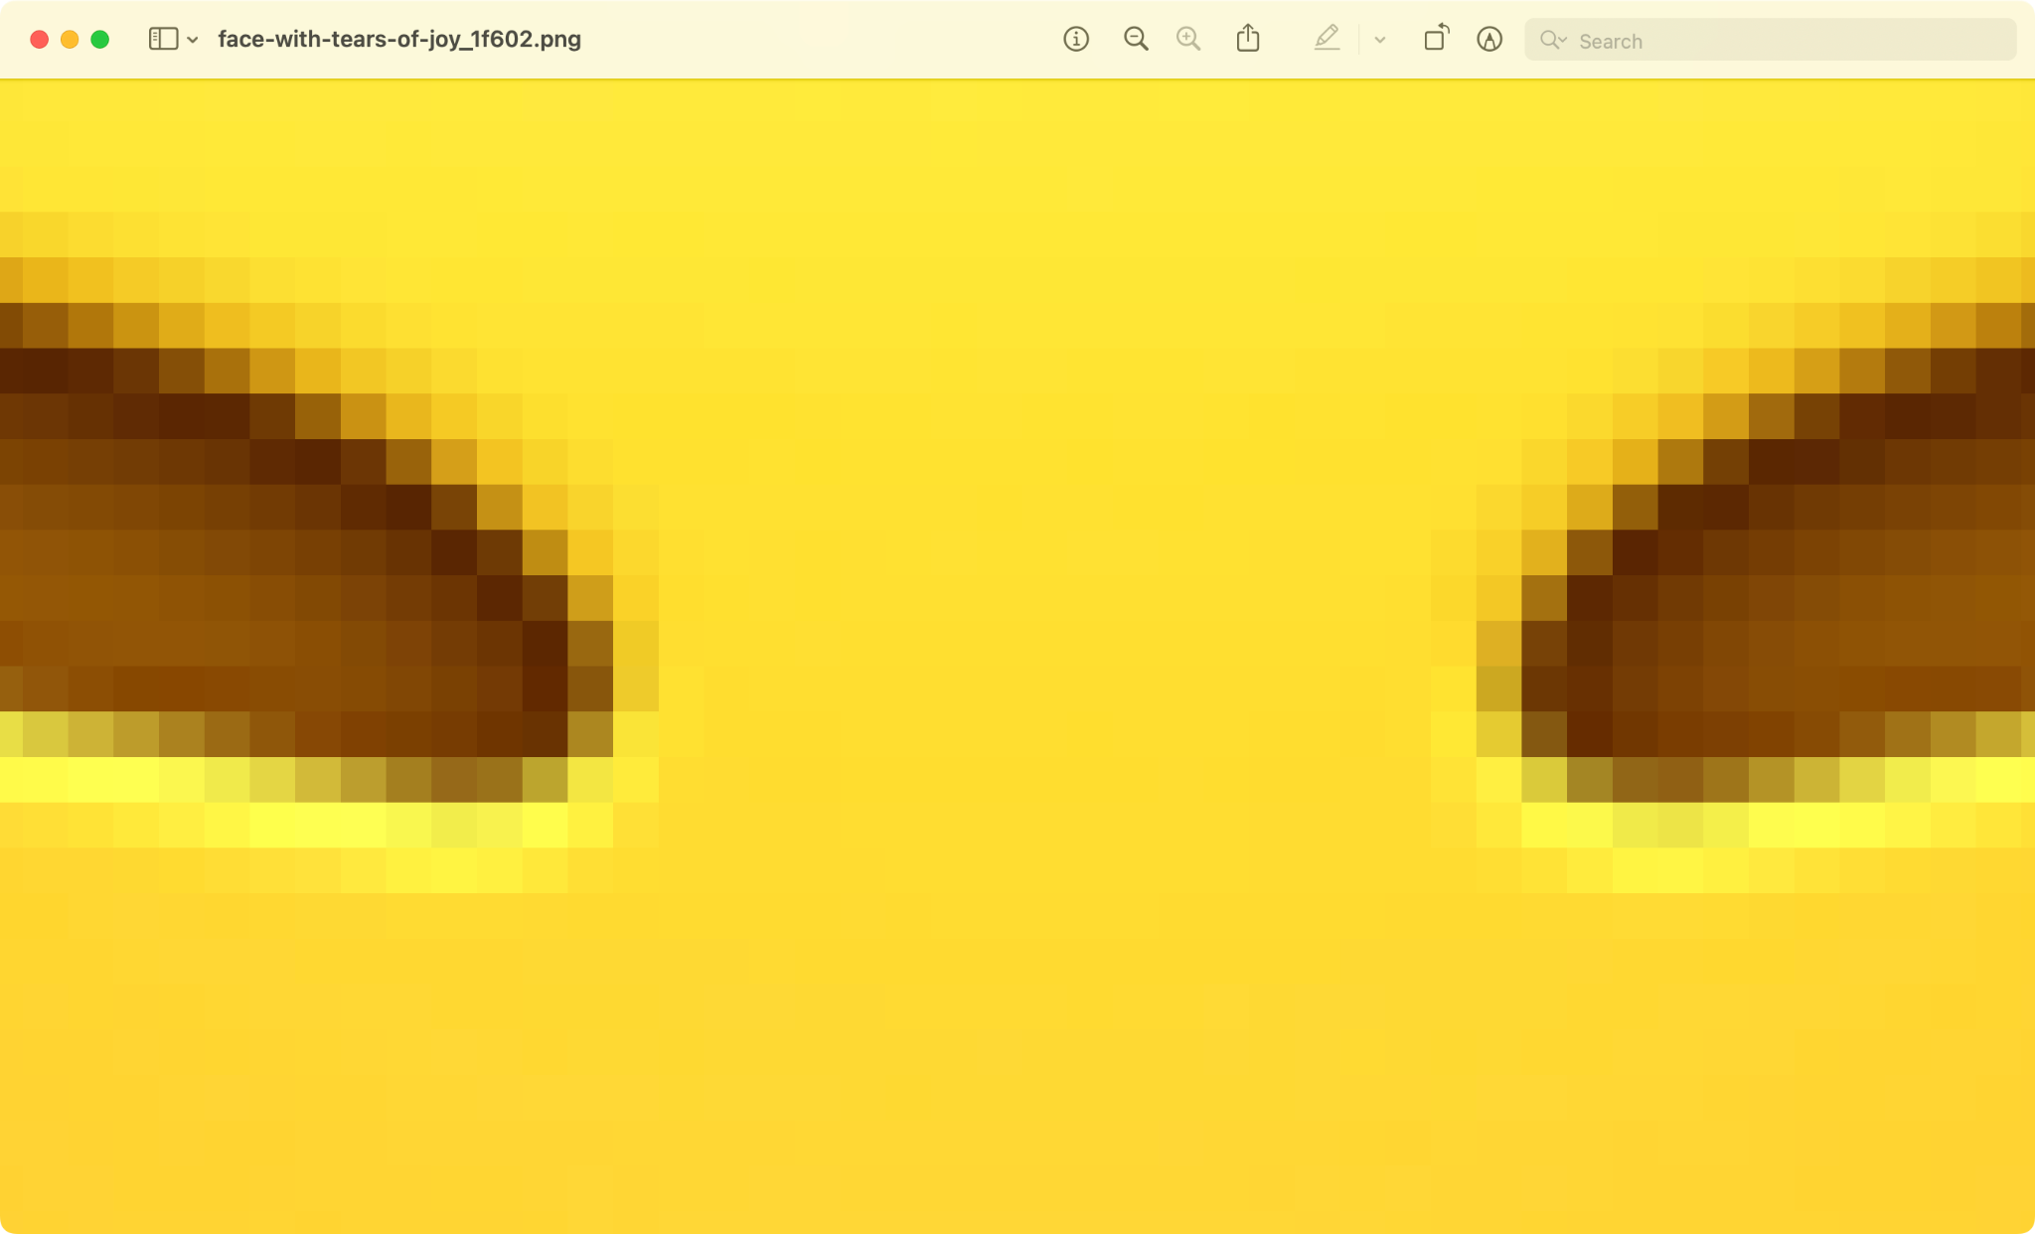

Slide 42
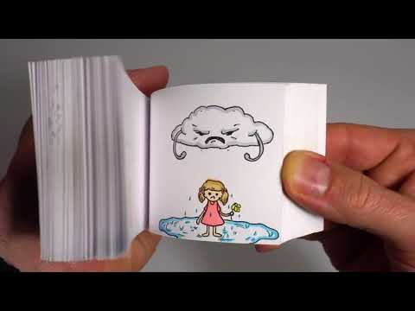

Slide 43
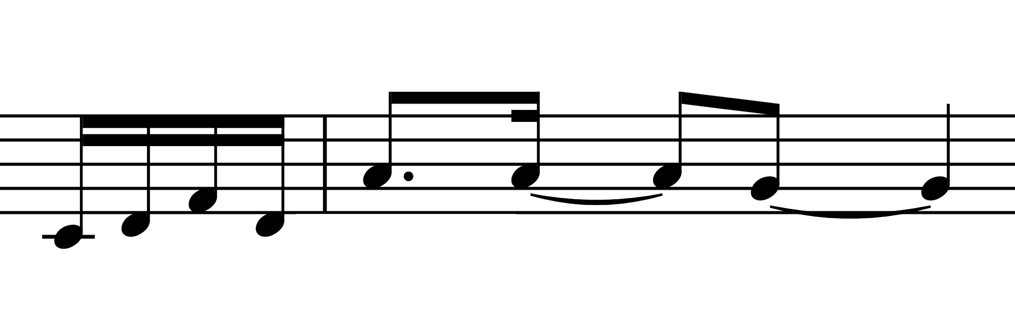

Slide 44
input →
→ output

Slide 45
algorithm

Slide 46
code

Slide 47
abstraction

Slide 48
implementation details

Slide 49


Slide 50
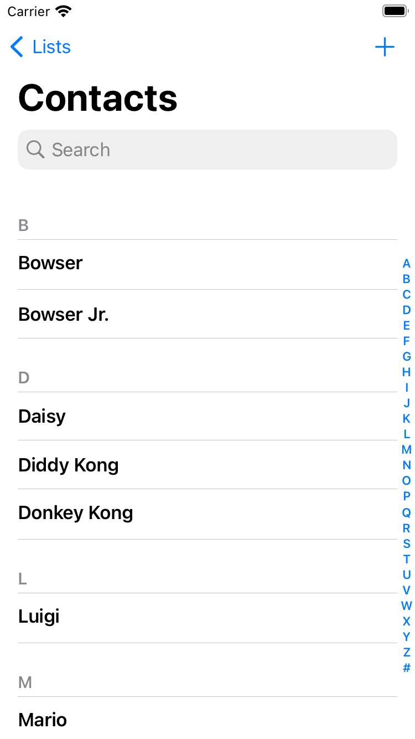

Slide 51
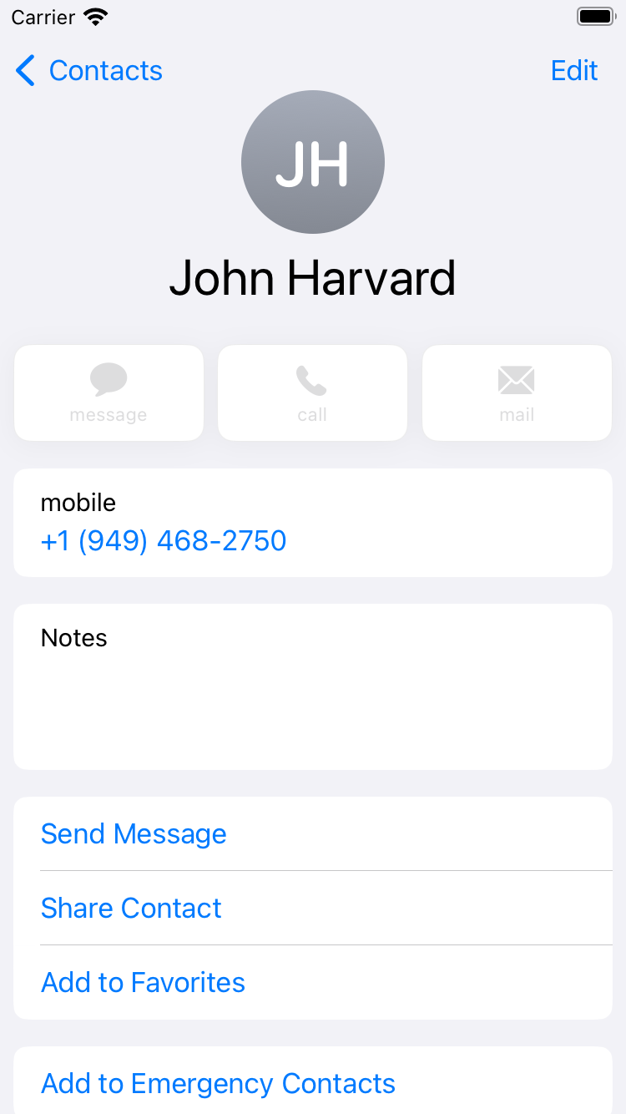

Slide 52
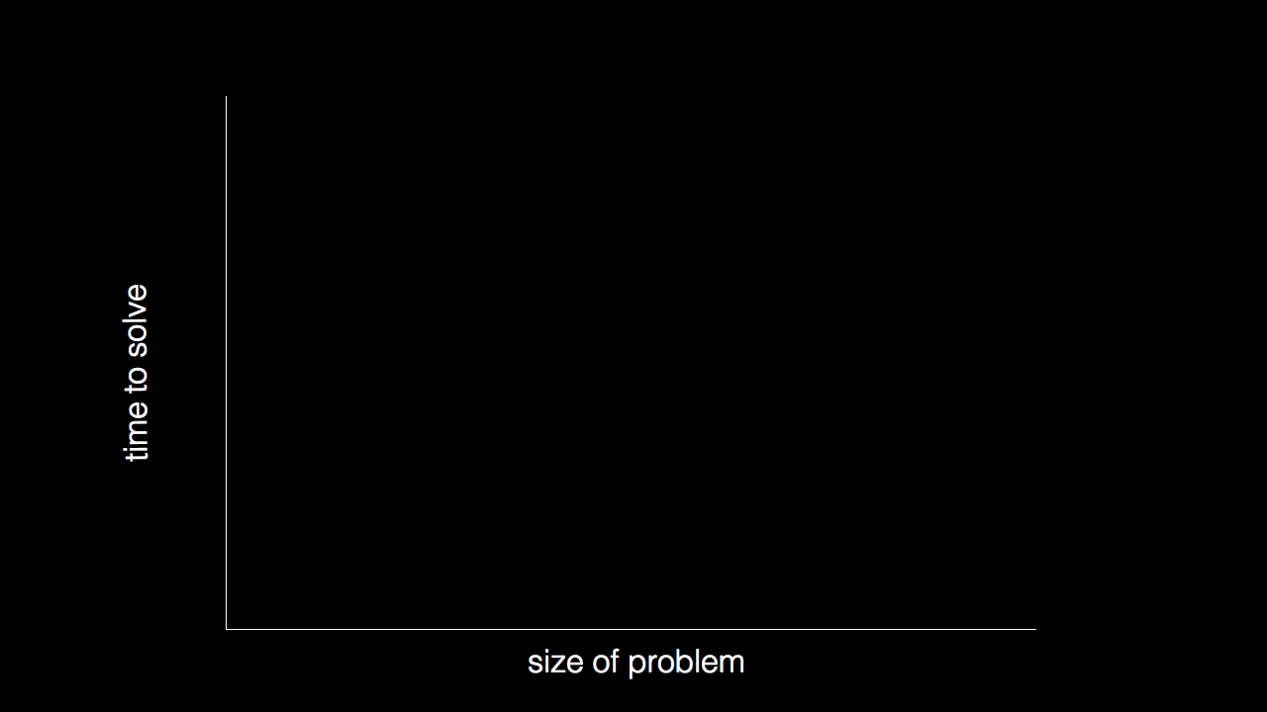

Slide 53
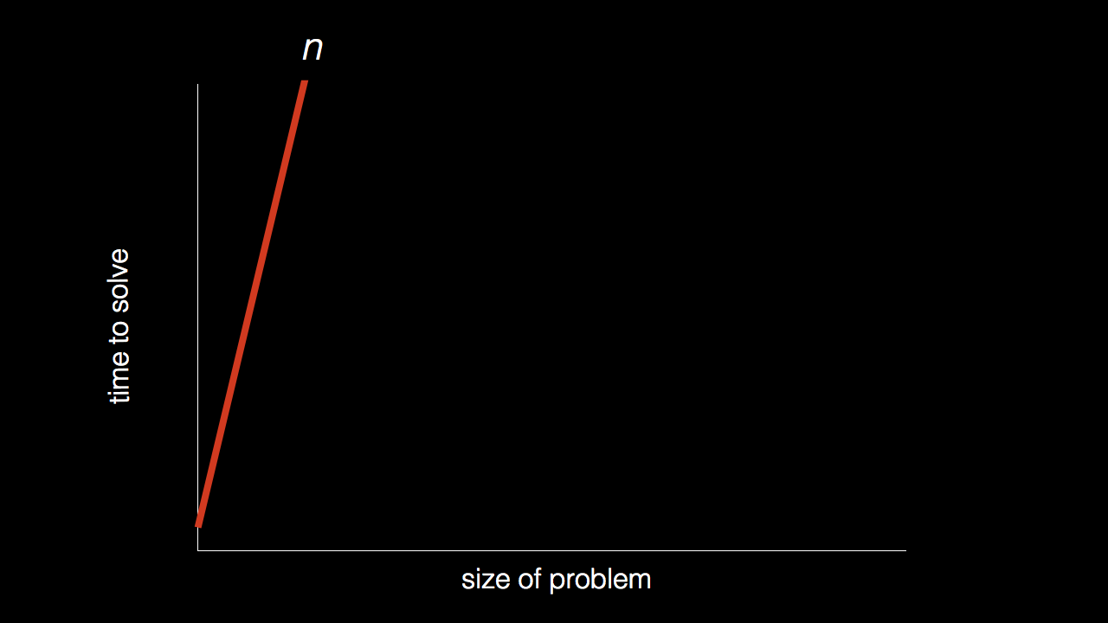
n

Slide 54
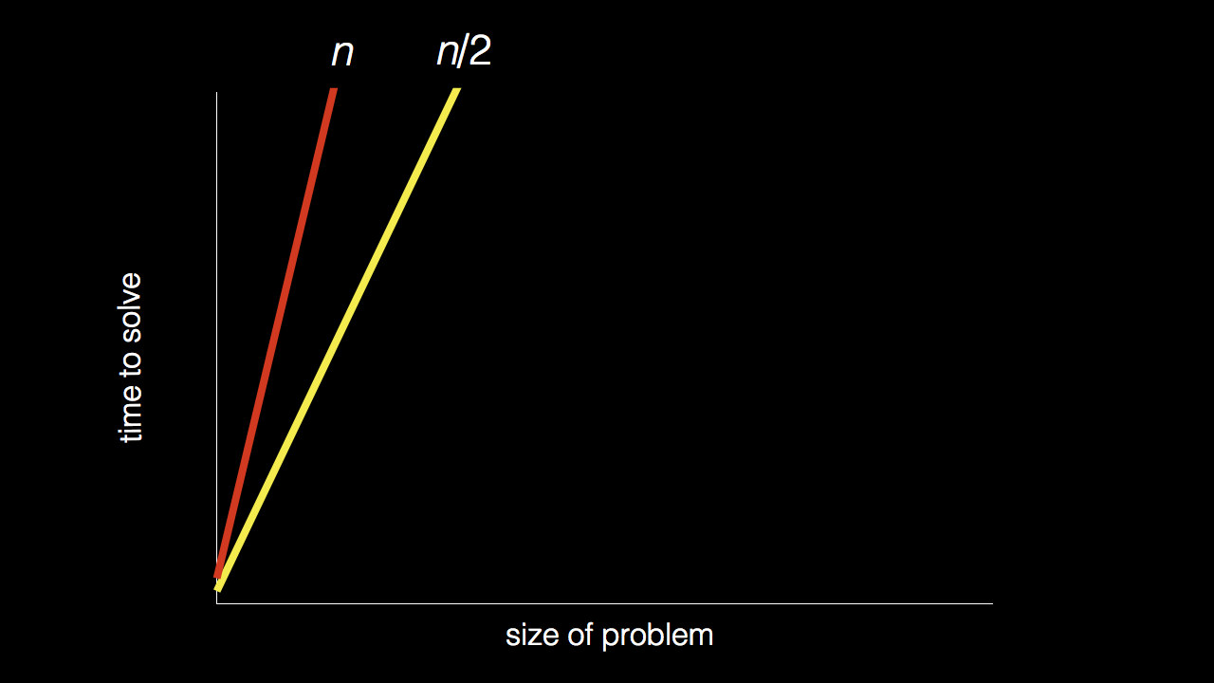
n
n/2

Slide 55
n
n/2

Slide 56
n
n/2

Slide 57
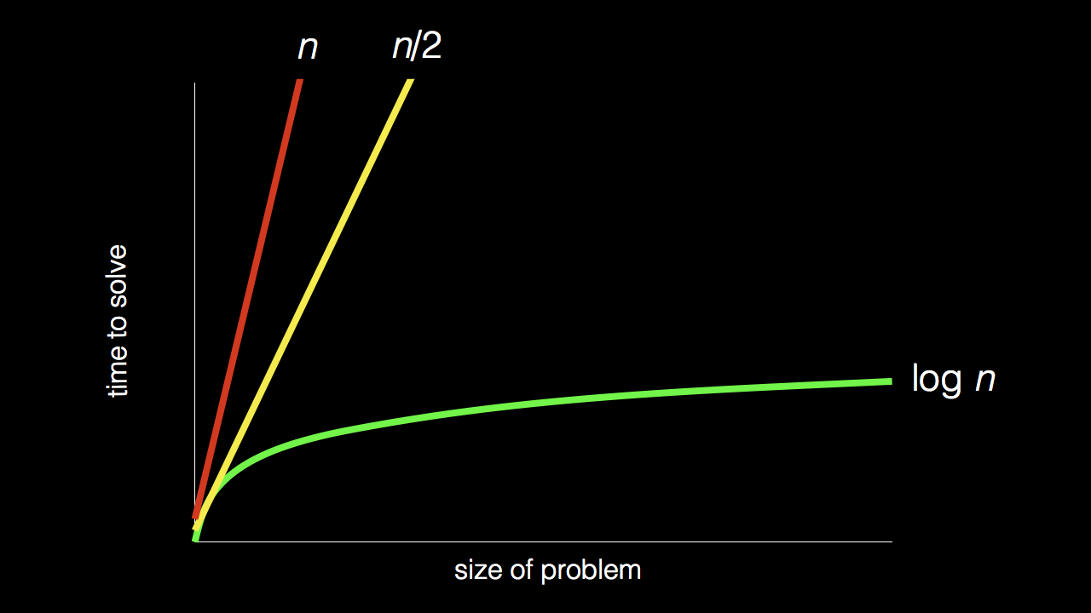
n
n/2
log₂ n

Slide 58
pseudocode

Slide 59
1 Pick up Dictionary
2 Open to middle of Dictionary
3 Look at page
4 If word is on page
5 Print word
6 Else if word is earlier in dictionary
7 Open to middle of left half of dictionary
8 Go back to line 3
9 Else if word is later in dictionary
10 Open to middle of right half of dictionary
11 Go back to line 3
12 Else
13 Quit

Slide 60
1 Pick up Dictionary
2 Open to middle of Dictionary
3 Look at page
4 If word is on page
5 Print word
6 Else if word is earlier in dictionary
7 Open to middle of left half of dictionary
8 Go back to line 3
9 Else if word is later in dictionary
10 Open to middle of right half of dictionary
11 Go back to line 3
12 Else
13 Quit

Slide 61
1 Pick up Dictionary
2 Open to middle of Dictionary
3 Look at page
4 If word is on page
5 Print word
6 Else if word is earlier in dictionary
7 Open to middle of left half of dictionary
8 Go back to line 3
9 Else if word is later in dictionary
10 Open to middle of right half of dictionary
11 Go back to line 3
12 Else
13 Quit

Slide 62
1 Pick up Dictionary
2 Open to middle of Dictionary
3 Look at page
4 If word is on page
5 Print word
6 Else if word is earlier in dictionary
7 Open to middle of left half of dictionary
8 Go back to line 3
9 Else if word is later in dictionary
10 Open to middle of right half of dictionary
11 Go back to line 3
12 Else
13 Quit

Slide 63
1 Pick up Dictionary
2 Open to middle of Dictionary
3 Look at page
4 If word is on page
5 Print word
6 Else if word is earlier in dictionary
7 Open to middle of left half of dictionary
8 Go back to line 3
9 Else if word is later in dictionary
10 Open to middle of right half of dictionary
11 Go back to line 3
12 Else
13 Quit

Slide 64
functions conditionals Boolean expressions loops …

